Slide 1
Introduction to Machine Learning tools in NLP

Slide 2
Common ML models for classification
常用的机器学习分类模型
Decision Tree, Bayes, HMM, Maximum Entropy, KNN, Boosting, Support Vector Machine , Conditional Random Field, NN, Evolutionary Algorithms… 决策树模型、贝叶斯模型、HMM模型、最大熵模型、KNN模型、Boosting、支持向量机、条件随机场、神经网、遗传算法等
We focus on Naïve Bayes, ME and CRF 我们今天简单介绍一下NB, ME和CRF
A good review paper: 一篇较好的综述性文章是： L. Marquez, Machine Learning and Natural Language Processing

Slide 3
Outline
ML Framework 机器学习框架
Naïve Bayes 朴素贝叶斯模型
Maximum Entropy Models 最大熵模型
  Features
  Maximum Entropy Principle
  Maximum Likelihood
  Parameters Estimation
  Application

Slide 4
Outline
Conditional Random Fields 条件随机场介绍
Unifying characterization of ML
Nonlinear Models and Deep Learning
End-to-end Learning

Slide 5
Machine Learning
Test
Set
Training
Set
Learning
Algorithm
Learned
Model
Representation? 如何表示？Features！
Classification/
Generation
Results
  What classes? 什么样的类？
  Binary vs. multivalued
  Disjoint vs. overlapping

Slide 6
Types of ML 机器学习分类
监督学习(supervised learning)
非监督学习(unsupervised learning)
半监督学习(semi-supervised learning)
弱监督学习(weakly-supervised learning)
强化学习(reinforcement learning)
深度学习(deep learning)

Slide 7
Modeling：Different Types of Learners
Decide how to represent learned models:
  Decision rules
  Linear functions (SVM)
  Markov models
  …
A “good” hypothesis should be “consistent” with the training data, and also has good generalization accuracy (on new data)

Slide 8
Estimating Generalization Accuracy
Accuracy on the training says nothing about new examples! Really 真的吗？
Must train and test on different example sets
If development sets are provided, they can be used to tune the model parameters; if not , we can estimate generalization accuracy over multiple train/test divisions (e.g. k-fold cross validation)
Test sets should only to used once to measure final performance.

Slide 9
Baidu got caught cheating in the ImageNet challenge!
https://www.engadget.com/2015/06/03/baidu-imagenet-ai-supercomputer-test/
The issue began in Mid-May when Baidu claimed to have scored a record low 4.58% error rate on the test. This exam looks at how well computing clusters can identify objects and locations within photographs -- basically the technology behind Google Photo's auto-tagging feature -- except on large-scale file sets. Microsoft and Google, on the other hand scored 4.94 and 4.8 percent error rates, respectively. That's actually a bit better than the 5 percent average trained humans can achieve and a huge deal for the industry.

Slide 10
Baidu got caught cheating in the ImageNet challenge!
However on Tuesday, researchers who actually administered the ImageNet test called shenanigans on Baidu for setting up a series of dummy accounts to brute force a successful test run. The test rules state specifically that contestants are allowed to submit only two sets of test results each week. Baidu apparently set up 30 accounts and spammed the service with 200 requests in six months, 40 of which came over a single five-day period in March. Doing so potentially allowed Baidu engineers to artificially increase the recognition rate by "tuning" their software to the existing test data sets.

Slide 11
Estimating Generalization Accuracy
Sources of error:
  Noise：data cleaning 需要数据清理
  Bias: Systematic error? Depends on the model
  Variance: How much the estimate changes between different runs
  Overfitting: performance is good on training data but bad on test data. It should be avoid (e.g. by regularization or feature reduction)

Slide 12
Classification problems分类问题
很多问题都可以表述为分类问题：
(x1,y1),(x2,y2),....(xn,yn)
这里xi是数据或数据的某种表示，yi是类别。在NLP中，xi一般表示句子。
如在机器翻译的译词选择中，x表示原文单词及其语境，y表示译文，则
（漂亮 女孩，pretty)，
（漂亮 夫人，beautiful)，
（漂亮 男人，handsome)，...
又比如在文本分类中，xi是某个文本，yi就是该文本的类别，如政治、经济、科技等。

Slide 13
Random process 随机过程
又比如在词性标注中，x表示待标注词的前后文，y表示该词的标注，则
（前一个词为modal, 这个词为verb）,
（前一个词为det, 这个词为adj）,......
把（x,y)作为一个随机过程，x的集合构成X，y的集合构成Y. Y一般是离散的
（x,y)构成样本空间。给定一个训练样本，我们感兴趣的概率模型是P(Y=y|X=x)，一般写作 P(y|x)。如何建立该模型？

Slide 14
Feature functions 特征函数
我们引入特征函数的概念来更加细致地表达样本的性质
f: X×Y → {0,1}
称为布尔特征函数。如
f(x,y)=1: if (x=漂亮，后面跟“男人”）& (y=handsome)
0: otherwise

Slide 15
特征函数
可以引入任意多个特征函数f_{i}(x,y)，一般特征函数的形式为f_{i}(x,y)≡φ(x)∧y=c.
虽然我们这里只考虑布尔特征，但是实际上特征函数可以是：f:X×Y→R (实数集),（后面我们会看到，布尔特征也够了）

Slide 16
样本表示
有了特征函数，样本x可以表示为
x=(f₁, f₂, f₃, …, f_{n})
也就是说，这些特征函数在样本上取值为1
因此， P(y|x)=P(y|f₁, f₂, f₃, …, f_{n})
比如：P(男人|有胡须，光头，穿西装)
  P(女人|长头发，穿裙子)

Slide 17
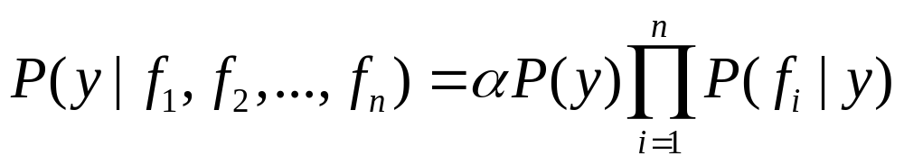
Naïve Bayes 朴素贝叶斯模型
According to Bayes formula 根据贝叶斯公式
Assume Independence between features 假设特征之间相互独立，则
This is called 这称为Naïve Bayes Model

Slide 18
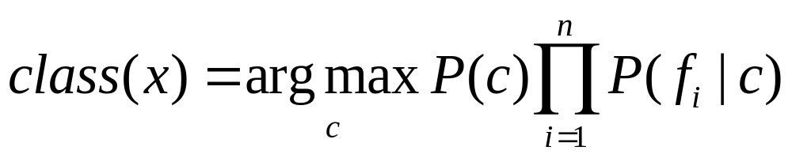
NBC的MAP决策
图形表示
C
……
f1
f2
fn

Slide 19
NBC Application：Text Classification
Task: classify text documents into one of the pre-defined classes such as sports, recreation, politics, war, economy,…,etc,
Given
  K groups of training texts, each with a label, containing a number of text documents
Test
  On new data

Slide 20
Procedures
Computing a priori class probabilities
  Count the number of text documents in each class: Ni
  Total number of training text documents: N
  Prior probability P(Ci) = Ni / N

Slide 21
Computing class conditional word likelihoods
  Suppose we have chosen m key words, denoted as w1, w2,…,wm, as features
  Count the number of times – cji, that word wj occurs in text class Ci
  Count the number of words – Ni, in class Ci
  Class conditional probaiblity is P(wj | Ci) = cji / Ni

Slide 22
Classifying a new document d
  Compute the features of d, i.e., the number of times word wj occuring in d
  P(Ci|d) = P(Ci|w1,w2,…,wd)
  =α P(Ci)P(w1|Ci) (w2|Ci)… (wd|Ci)
  Assign d to the class I that has the maximum posterior probability

Slide 23
Details 细节
Preprocessing
  eliminating punctuation
  eliminating numerals
  converting all characters to lowercase
  eliminating all words with less than 4 letters
How to choose the key words wi’s?
  For each class, you can pick out the first k words that occurs most frequently
  For all the training data, pick out the first k works that appears most frequently
  Union all these words as key-words/features
问题：常用字和非常用字，哪个有用？

Slide 24


tfidf: weighting the words
tf(t,d)=count(t,d)/∑i count(ti,d)

Slide 25
Problems of NBC的问题
Independence assumption of features 要求特征独立，这在实际中经常不满足
但是，当特征很多的时候，效果还是不错，可以作为一个基准
下面我们探讨更精确的模型

Slide 26
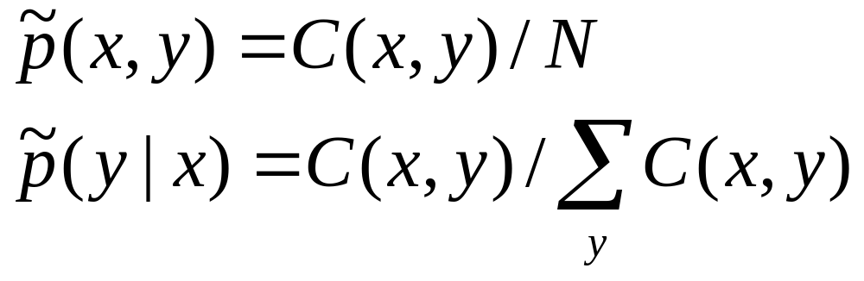
Sample distribution 样本概率分布
我们建立的模型，最好要符合训练样本，也就是说，P(y|x) 满足样本概率分布
比如，在样本里，如果“漂亮”翻译成“pretty”的概率为0.3，我们希望我们的模型的预测结果也一样。
最大似然估计肯定符合样本，但是不太好。

Slide 27
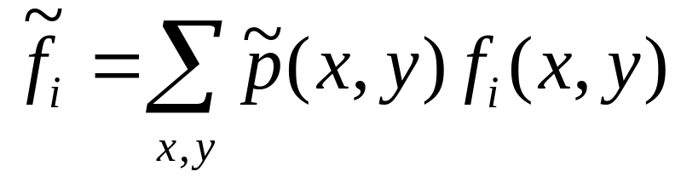
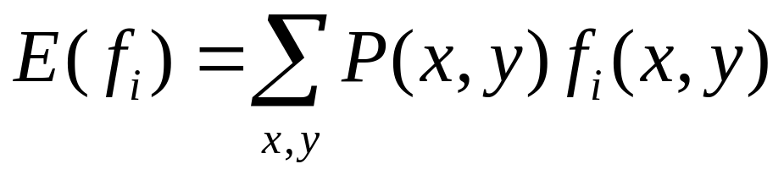
Features 特征
一个特征在样本中出现的次数，可以如下计算：
看起来复杂，其实只是数一数特征出现的次数
假如我们有一个联合概率模型P(x,y),则该模型下某个特征的期望值是

Slide 28
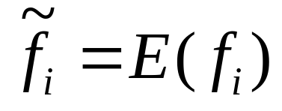
模型最好符合样本
我们希望
对所有的特征函数i=1,2,...N成立。
我们并且希望建立条件概率模型而不是联合概率模型，因为前者直接可以用于贝叶斯决策。

Slide 29
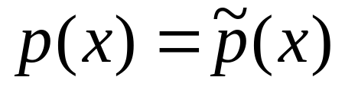
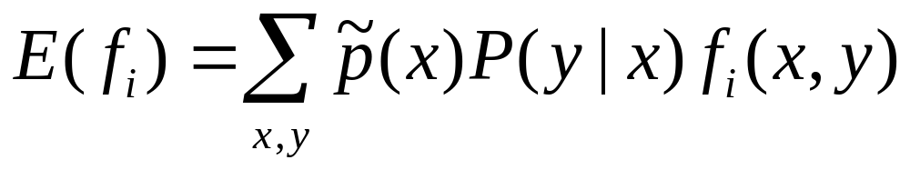
P(x,y)=P(x)P(y|x)
我们希望边际分布
因此
这样的条件概率模型与训练数据相符。这些特征方程表达对模型的限制。

Slide 30
Most general probability model最一般的概率模型
对于给定的训练样本，当确定好特征函数以及特征方程以后，可能有很多个模型满足特征限制。
如扔骰子，如样本中“扔出点数为1的概率” = 0.4，哪些模型满足呢？
  P(1)=0.4, P(2)=0.1, P(3)=0.1, P(4)=0.2,P(5)=0.1,P(6)=0.1
  P(1)=0.4, p（点数为2-6）=（1-0.4)/5=0.12
  ......
哪一个模型好呢？
最一般的模型是满足限制的尽可能均匀分布的概率模型

Slide 31
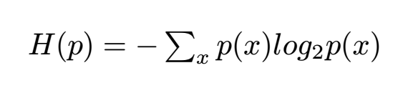
Maximum Entropy Principle 最大熵原则
The model with maximum entropy is the most general model. 熵最大的模型是最一般的概率模型
  make things as simple as possible，but not simpler;
  do not pretend you know something you don’t
entropy

Slide 32
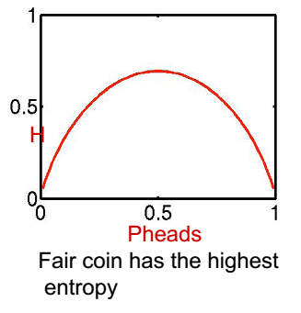
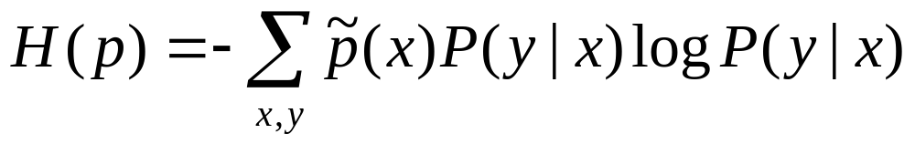
Maximum Entropy Principle 最大熵原则
模型p(y|x)的条件熵：
p*=argmax _{p} H(p)

Slide 33
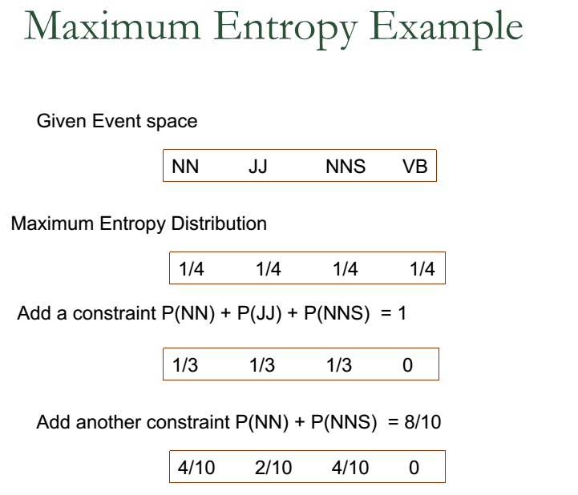


Slide 34
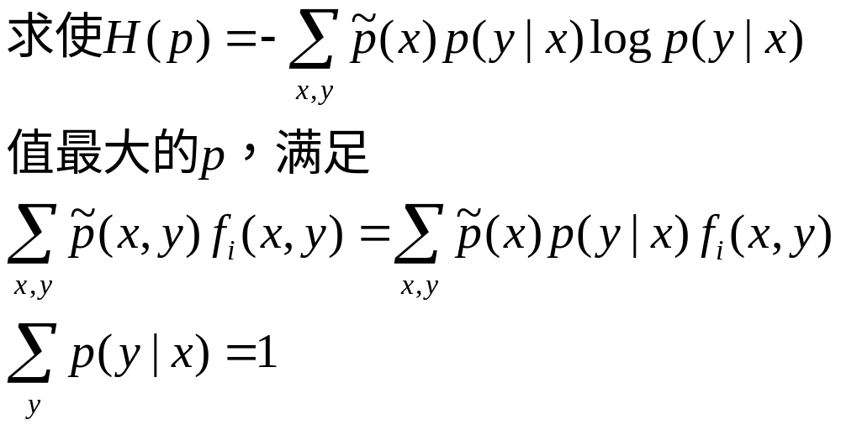
最大熵模型求解
问题：满足限制条件下的极值问题
Use Lagrange Multipliers 采用拉格朗日乘子法

Slide 35
拉格朗日乘子法
带约束的优化问题
拉格朗日法 ->
不带约束的优化问题
求偏导数法 ->
方程
解方程 ->
原问题的解

Slide 36
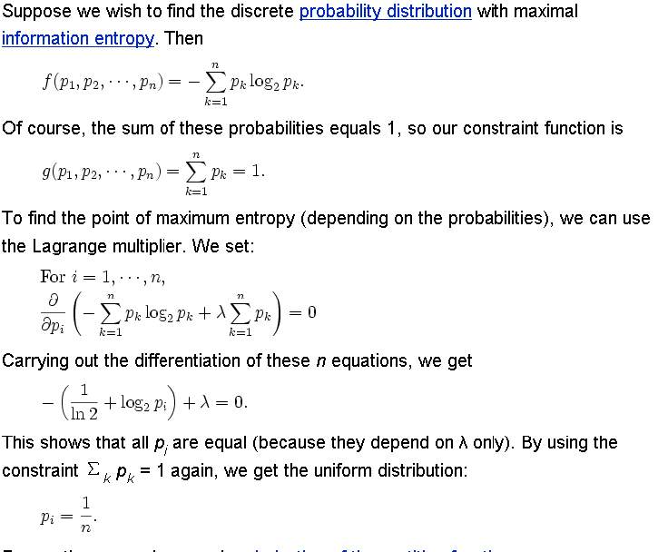

Slide 37
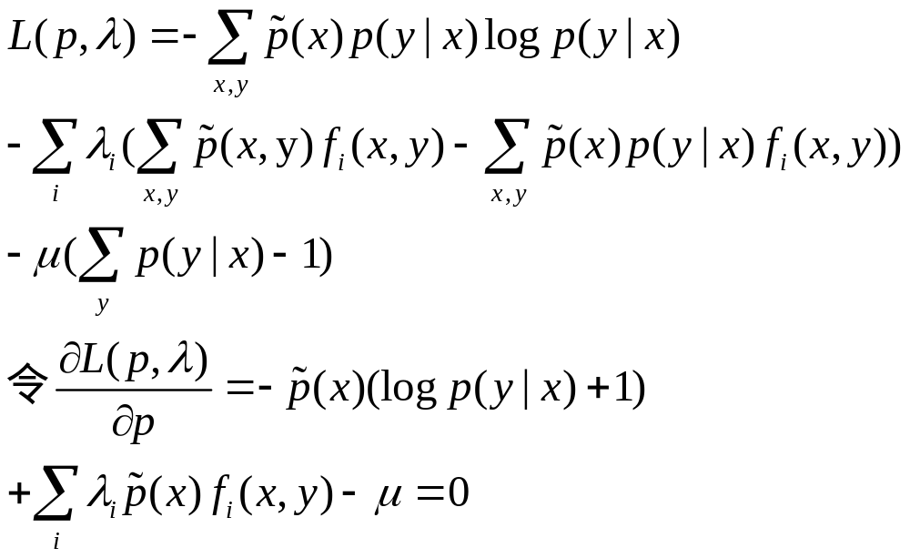
Entropy is convex 熵是凸函数，解唯一

Slide 38
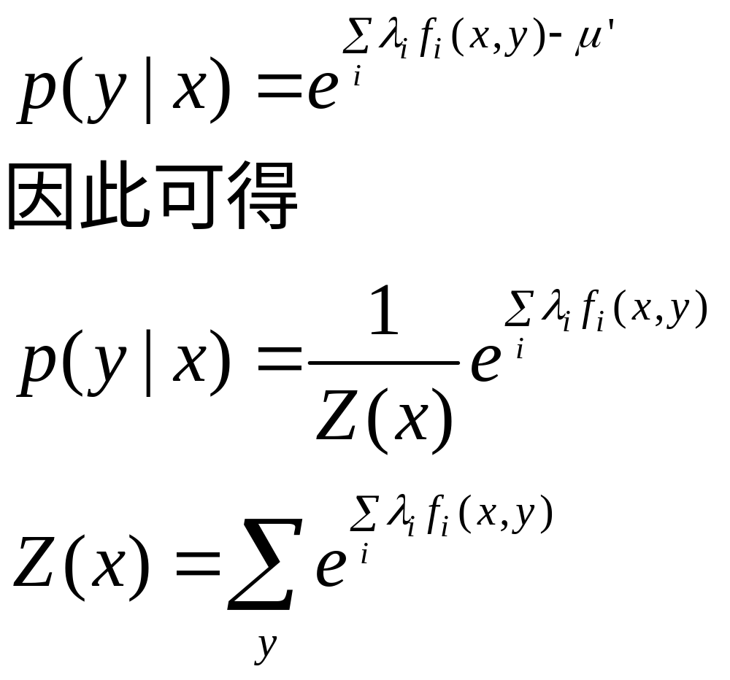

Slide 39
其中，Z(x) 称为 normalization factor，也称为partition function
模型具有指数形式。求对数：
log(p*)= ∑_{i} λ _{i} f _{i}(x,y) – log(Z(x))
因此也叫 log-linear model
上述求解过程假设λ _{i} 不变。
如何求解λ _{i}?

Slide 40
Parameter estimation of λ参数估计
无法精确求解，只能采用数值计算方法：
  GIS
  IIS
  Gradient descent 梯度法
  Quasi-Newton Methods 有限内存拟牛顿法

Slide 41
Generalized Iterative Scaling 算法
GIS算法可以求出模型中特征的权重λ_{i}
G.I.S. needs, in order to work,
∀x,y Σ_{i=1..N} f_{i}(x,y) = C
  to fulfill, define additional constraint:
  f_{N+1}(x,y) = C_{max} - Σ_{i=1..N} f_{i}(x,y), where C_{max} = max_{x,y} Σ_{i=1..N} f_{i}(x,y)
  E_{p}(f_{i}) = Σ_{x,y}p(x,y)f_{i}(x,y) ≅ 1/|T| Σ_{t=1..T}Σ_{y∈Y}p(y|x_{t})f_{i}(x_{t},y)

Slide 42
algorithm
1. Initialize λ_{i}⁽¹⁾ (any values, e.g. 0), compute d_{i}=E’(f_{i}(y,x)), i=1..N+1
2. Set iteration number n to 1.
3. Compute current model distribution expected values of all the constraint expectations
E_{p(n)}(f_{i}) (based on p^{(n)}(y|x_{t}))
4. Update λ_{i}^{(n+1)} = λ_{i}^{(n)} + (1/C) log(d_{i}/E_{p(n)}(f_{i})) [Δλ_{i}]
5. Repeat 3.,4. until convergence.

Slide 43
Improved Iterative Scaling （Berger)
求Δλ_{i}满足E_{p(n)}(f_{i}) =Σ_{xy}p’(x)p^{(n)} (y|x)f_{i}(x,y)exp(Δλ_{i}f#(x,y)) = E’(f_{i}(x,y))=d_{i}
Update λ_{i}^{(n+1)} = λ_{i}^{(n)} + Δλ_{i}

Slide 44
关于λ的说明
技术上，λ是拉格朗日乘子
实际上，表示特征的权重
  λ＝0，无用特征
  λ＝∞，最佳分类特征（就是它！）
  λ＝－∞，反向分类特征（肯定不是它！）
我们前面提到，不需要实数特征函数，因为可以用λ来体现

Slide 45
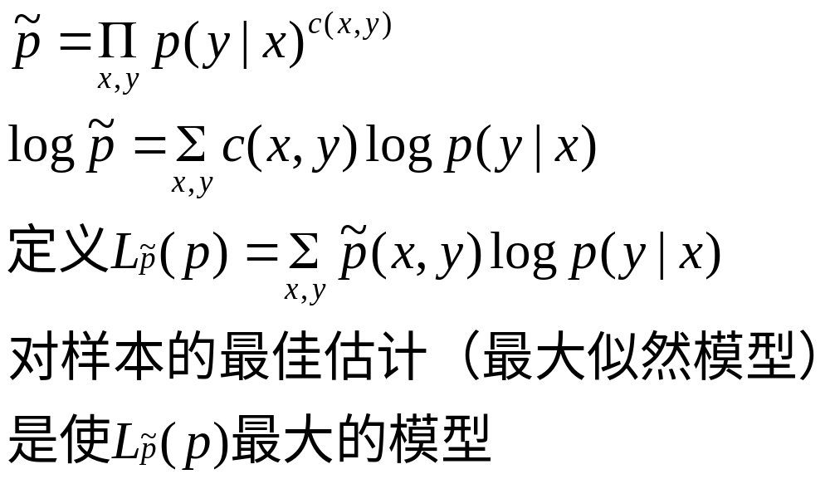
最大熵模型的合理性
给定一个条件概率模型，其训练样本的（条件）概率为

Slide 46
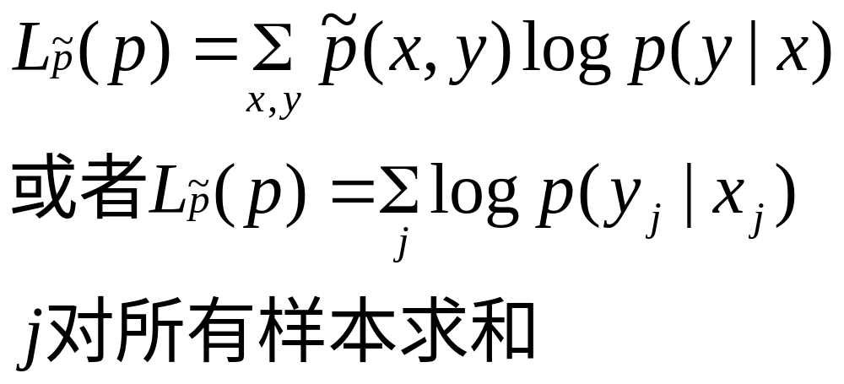
（条件）最大似然
找出使下列最大的λ值

Slide 47
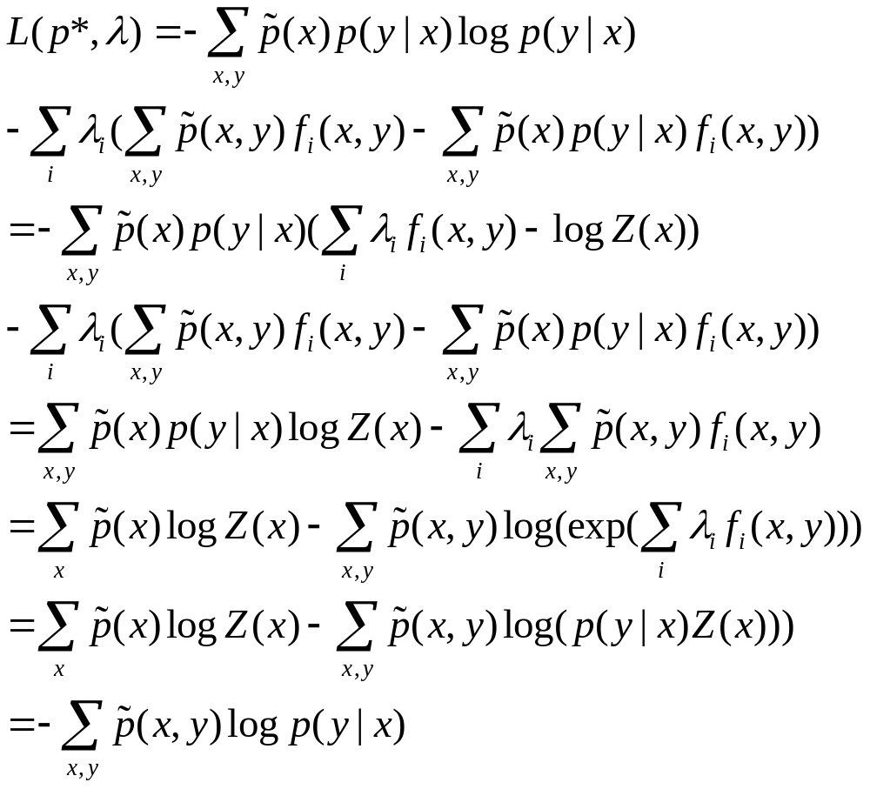
我们可以忽略L(p,λ)最后一项

Slide 48
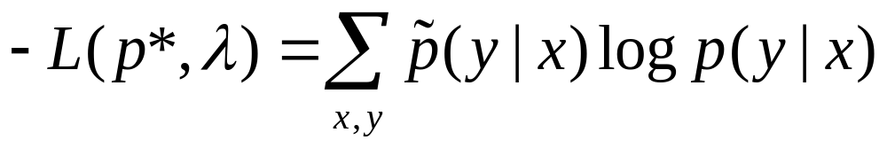
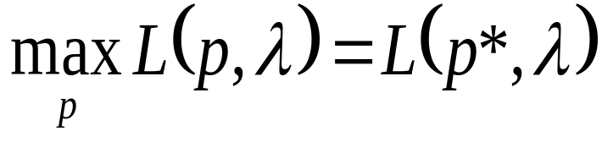
根据Kuhn-Tucker定律，使
最小化的λ*使L(p*, λ*)最大：
λ*=argmin λ L(p*, λ)
使样本(条件)概率最大的模型是满足受限条件的最大熵模型！
最大熵＝最大似然！
这说明了最大熵模型的合理性。（回想：最大熵是满足约束条件的！）

Slide 49
Advantages of ME最大熵的好处
No independence Assumption between features 特征之间不要求独立，可以使用任意特征

Slide 50
最大熵的问题
最大熵模型不假设模型服从什么分布，但是要求模型在训练数据上对每个特征的期望值符合训练数据，会导致过度拟合（overfitting）这使得对于新数据缺乏适应性。这正如最大似然估计不是最好的概率函数。
如果知道训练数据符合某种分布，如高斯分布、指数分布，我们可以利用这些先验分布来减少overfitting

Slide 51
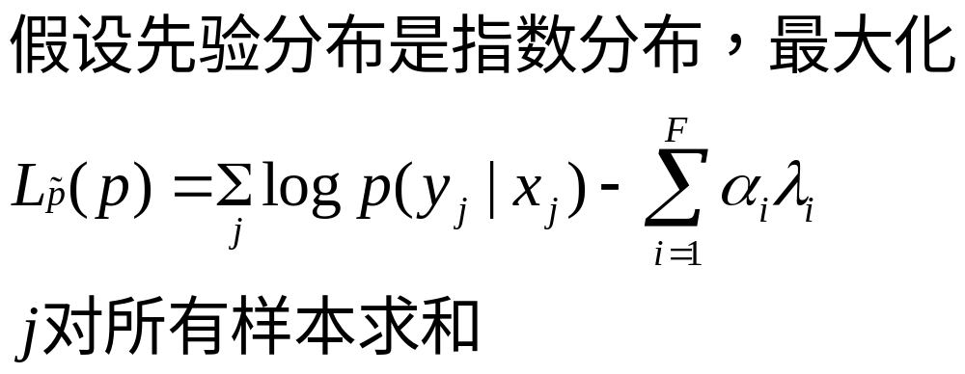
Exponential Prior
Joshua Goodman ：
Exponential Priors for Maximum Entropy Models (2004)

Slide 52
特征选择问题
MaxEnt的优点是可以任意选择你认为有用的特征
虽然可以自动选择特征权重，但是太多的特征导致效率降低
Berger提出贪心算法选择特征：初始识特征集为空，每次增加使训练样本的log-likelihood增加最大的特征。

Slide 53
算法步骤
有效特征集合E={}，令p为均匀分布
计算熵H(p)。
对以下步骤循环K次：
  对每个不在E里面的特征f_{i}，把E+{f_{i}}作为有效特征，计算熵H_{i}(p_{i})；
  假设H_{m}(p_{m})最小，则： E=E+{f_{m}}。

Slide 54
数据稀疏
出现次数很少的特征可靠吗？
Probably but it’s still useful
为了压缩模型，倒是可以采用count cutoff的办法

Slide 55
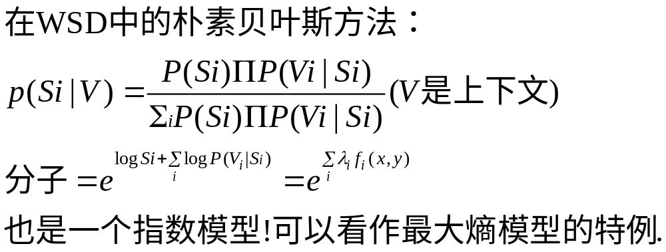
MaxEnt和Naive Bayes

Slide 56
Application of Maxent 最大熵模型的应用
POS tagging 词性标注（ Ratnaparkhi 1996）
Parsing 句法分析（ Ratnaparkhi 1999）
WSD (Gaustad 2004)
Named Entity Recognition 命名实体识别（Klein 2003)
Machine Translation 机器翻译（Och 2002）

Slide 57
MaxEnt features
对词性标注而言，环境x为每个词wi周围的上下文。如设
xi = (wi, wi+1,wi+2,wi-1,wi-2,ti-1, ti-2)
(ti表示词wi的词性）
特征函数如
f(xi, ti) = 1 if suffix(wi)=ing & ti=VBG
0 otherwise

Slide 58
标注算法
Xi 不是Wi
p(t1...tn|w1...wn)=Πp(ti|xi)，或
log p(t1...tn|w1...wn)=Σ_{i} log p(ti|xi)，或
= Σ _{i} ∑_{j} λ_{j} f_{j}(x,y)
维护一个N-best tag sequence, 自左至右计算

Slide 59
Toolboxes 几个工具包
Dekang Lin
F. J. Och
Zhang Le

Slide 60
Dekang Lin的最大熵模型工具包
基于GIS，采用指数先验模型
训练5次的测试结果比训练50次的结果好
对训练数据集吻合比较好的模型不一定对测试集效果好，如果两者的差别比较大。
实现说明
  每个特征和类的组合有一个权重
  如果特征不多，可以考虑用二维数组，否则可以用以特征作为索引的一维表

Slide 61
Och的最大熵模型工具包
仅132行C++代码
http://www.fjoch.com/YASMET.html

Slide 62
张乐的最大熵工具包
http://homepages.inf.ed.ac.uk/s0450736/maxent_toolkit.html

Slide 63
网络资源
http://homepages.inf.ed.ac.uk/s0450736/maxent.html
http://omega.albany.edu:8008/maxent.html
吴军对最大熵做过很有意思的解释，请大家参见http://googlechinablog.com/2006/10/blog-post.html

Slide 64
Introduction to CRF介绍
由John Lafferty最早用于NLP

Slide 65



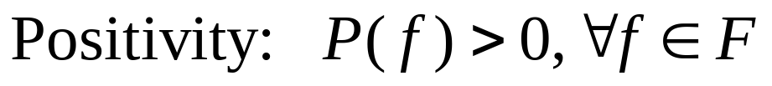
Markov Random Field
Random Field: Let be a family of random variables defined on the set S(1,2…M) , in which each random variable takes a value in a label set L. The family F is called a random field. Several kinds of random fields exist, among them the Markov random field (MRF), Gibbs random field (GRF), conditional random field (CRF), and Gaussian random field.
Markov Random Field: F is said to be a Markov random field on S with respect to a neighborhood system N if and only if the following two conditions are satisfied:
(local Markov)

Slide 66
A random field can be drawn in a graphical model: Associate each node of a graph with a random variable, and edges represents conditional dependencies. The graph is undirected. (If it is directed, it’s called a Baysian Network)

Slide 67
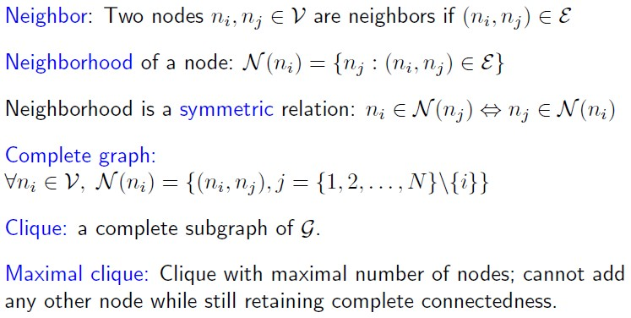
Some concepts

Slide 68
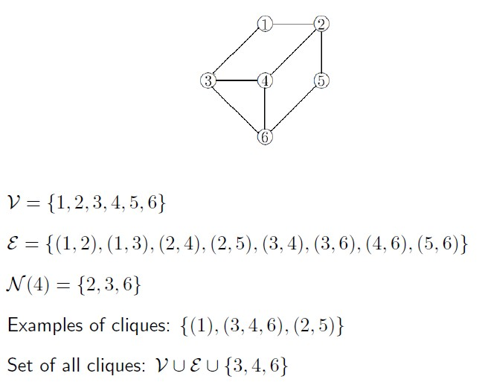
Example 例子

Slide 69
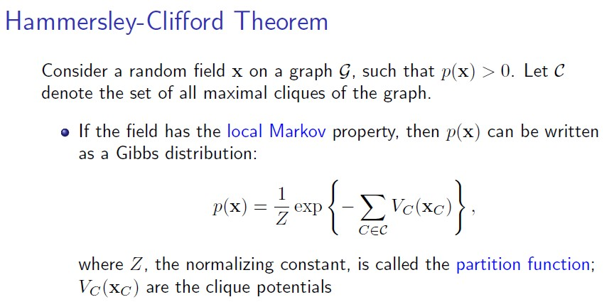

Slide 70
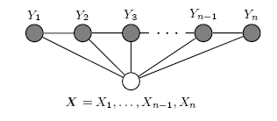
Conditional Random Field
Conditional Random Field: a Markov random field (Y) globally conditioned on another random field (X).
Figure 1: Graphical structure of a chain-structured CRFs for sequences. The variables corresponding to unshaded nodes are not generated by the model.

Slide 71
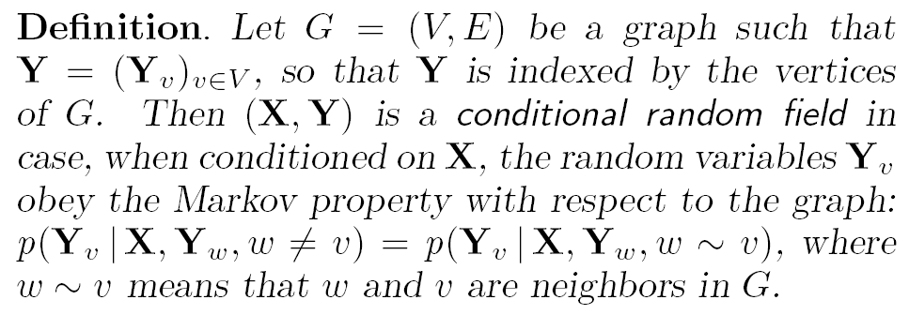
CRF - Definition
CRF最早由John Lafferty 等人引入用于序列标准（如词性标注），他们的定义是：
X is a random variable over data sequences to be labeled
Y is a random variable over corresponding label sequences
Notes:
A CRF is a random field globally conditioned on the observation X.

Slide 72
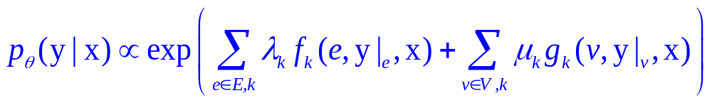
Fundamental Theorem of Random Fields (Hammersley & Clifford)
x is a data sequence
y is a label sequence
v is a vertex from vertex set V = set of label random variables
e is an edge from edge set E over V
f_{k} and g_{k} are given and fixed. g_{k} is a Boolean vertex feature; f_{k} is a Boolean edge feature
k is the number of features
are parameters to be estimated
y|_{e} is the set of components of y defined by edge e
y|_{v} is the set of components of y defined by vertex v

Slide 73
CRF – the Learning Problem
Assumption: the features f_{k} and g_{k} are given and fixed.
  For example, a boolean feature g_{k} is TRUE if the word X_{i} is upper case and the label Y_{i} is a “noun”.
The learning problem
  We need to determine the parameters Θ = (λ₁, λ₂, . . . ; µ1, µ2, . . .) from training data D = {(x(i), y(i))} with empirical distribution p~(x, y).

Slide 74
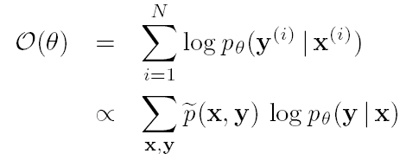
CRF – Estimation
And we return to the log-likelihood maximization problem, this time – we need to find Θ that maximizes the conditional log-likelihood:

Slide 75
CRF的参数估计
The parameter vector Θ that maximizes the log-likelihood is found using a iterative scaling algorithm (John Lafferty et al).
CRF同样是属于对数线性模型，因此用于最大熵的参数估计方法同样可以用于CRF模型，如Gradient Descendent Algorithm，伪牛顿算法等

Slide 76
CRF for sequence labelling 用于序列标注
CRF uses the markov property as HMM, so we can use dynamic programming, e.g. Vitierbi decoding. 像HMM一样，有高效的计算方法（Viterbi算法）
CRF can use arbitrary feature function as ME models. 像最大熵模型一样，可以使用任意特征

Slide 77
CRF工具包
CRF++: Yet Another CRF toolkit
Written in C++ with STL
Fast training based on LBFGS for large scale
Less memory usage both in training and testing；encoding/decoding in practical time
Available as an open source software
http://crfpp.googlecode.com/svn/trunk/doc/index.html

Slide 78
CRF模型要点
团(Cliché)的定义是CRF的关键。线性链只是CRF的最简单情形。
CRF的特色：P（Y|X）利用了条件场（X）的全局特征和目标场（Y）的局部特征。后者导致了动态规划为主导的高效解码。

Slide 79
几个模型的比较
Naive Bayes and Maxent models: label y is atomic, x can be structured (e.g., set of features)
HMMs and CRFs are extensions of Naive Bayes and Maxent models where y is structured too
HMMs and CRFs model dependencies between components y_{i} of label y

Slide 80
Model Comparison 几个模型的比较
These models are called probabilistic graphic models 这几个都是概率图模型
Naive Bayes and HMM：directed graph models 有向图模型（另外，Bayes Network 贝叶斯网络也是有向图模型）
Maxent models and CRFs：undirected graph models 无向图模型

Slide 81
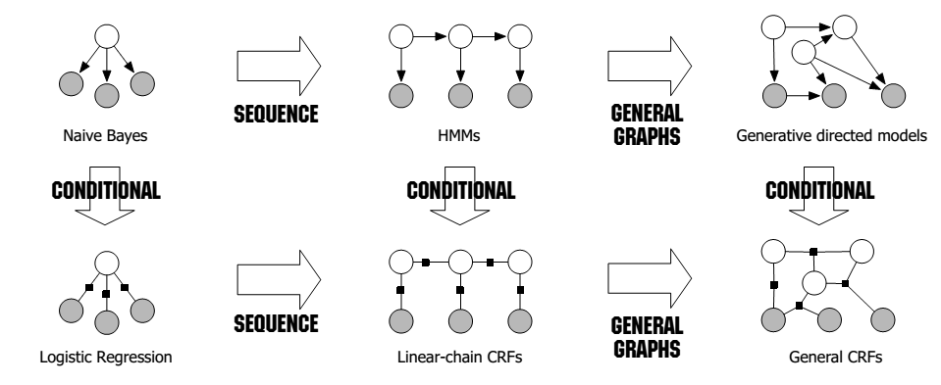
Probalistic Graphical Models 概率图模型一览[Charles Sutton : An Introduction to Conditional Random Fields]

Slide 82
几个模型的比较
生成模型（generative)：
  Joint distribution 计算联合分布
  Naive Bayes and HMM
判别模型（discriminative)
  Conditional distribution 计算条件分布
  Maxent models and CRFs
Discriminative models are usually more accurate 一般后者用起来准确率更高

Slide 83
几个模型的比较
最大似然和条件最大似然：
  Naive Bayes and HMM：最大似然
  Maxent models and CRFs：条件最大似然

Slide 84
Collins’s characterization of ML
Michael Collin gave a very good characterization of the classical machine learning methods, and proposed a perceptron algorithm to train the model parameters

Slide 85
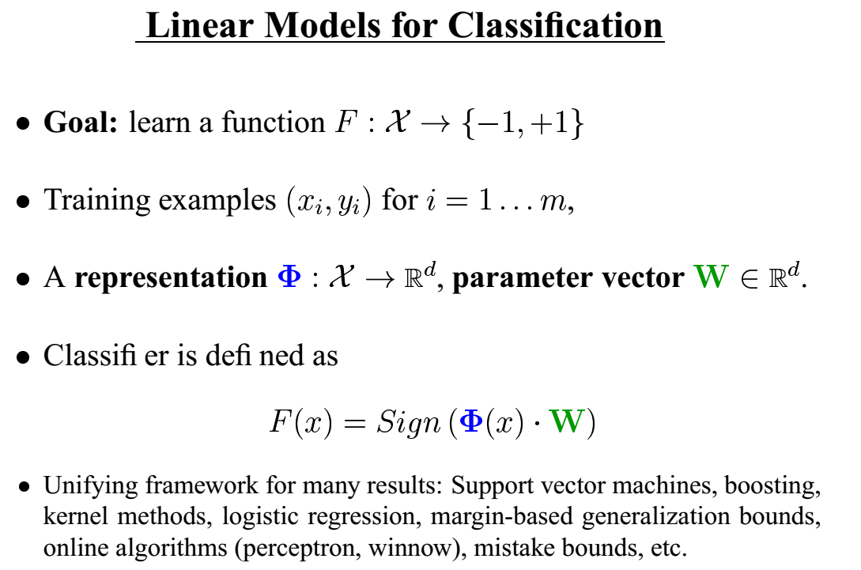

Slide 86
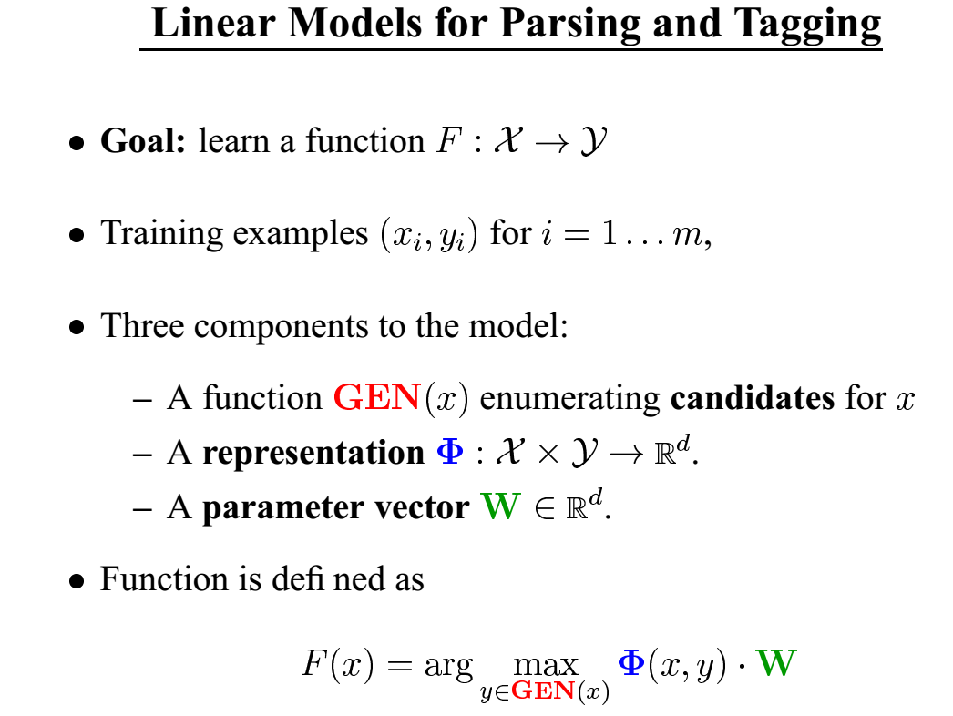

Slide 87
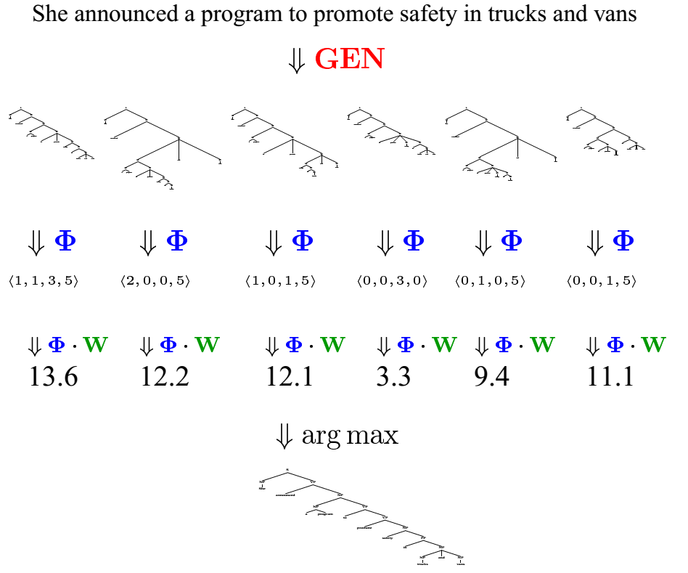

Slide 88
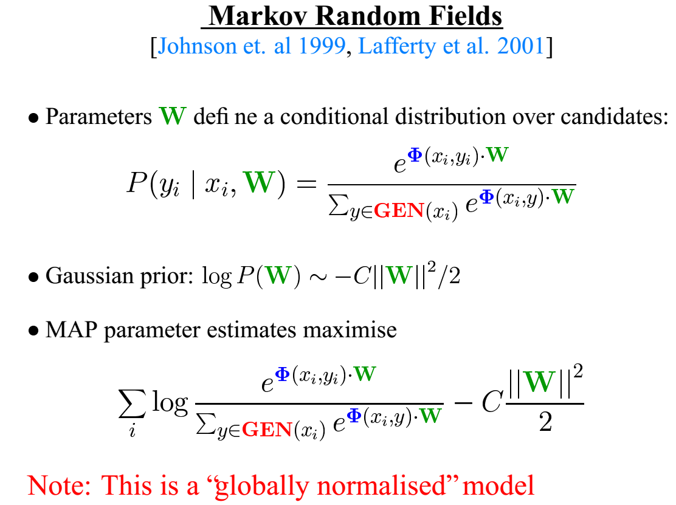

Slide 89
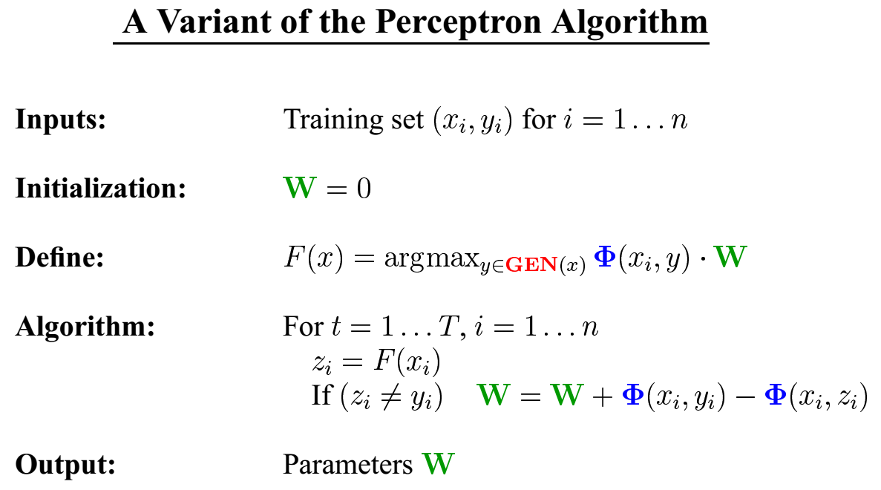

Slide 90
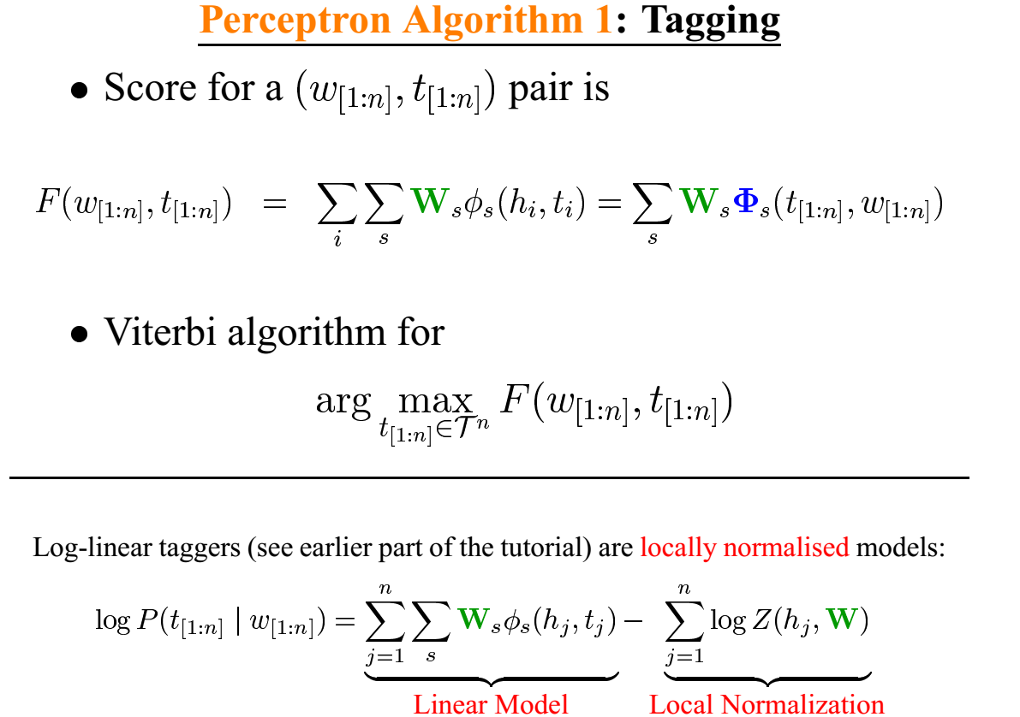

Slide 91
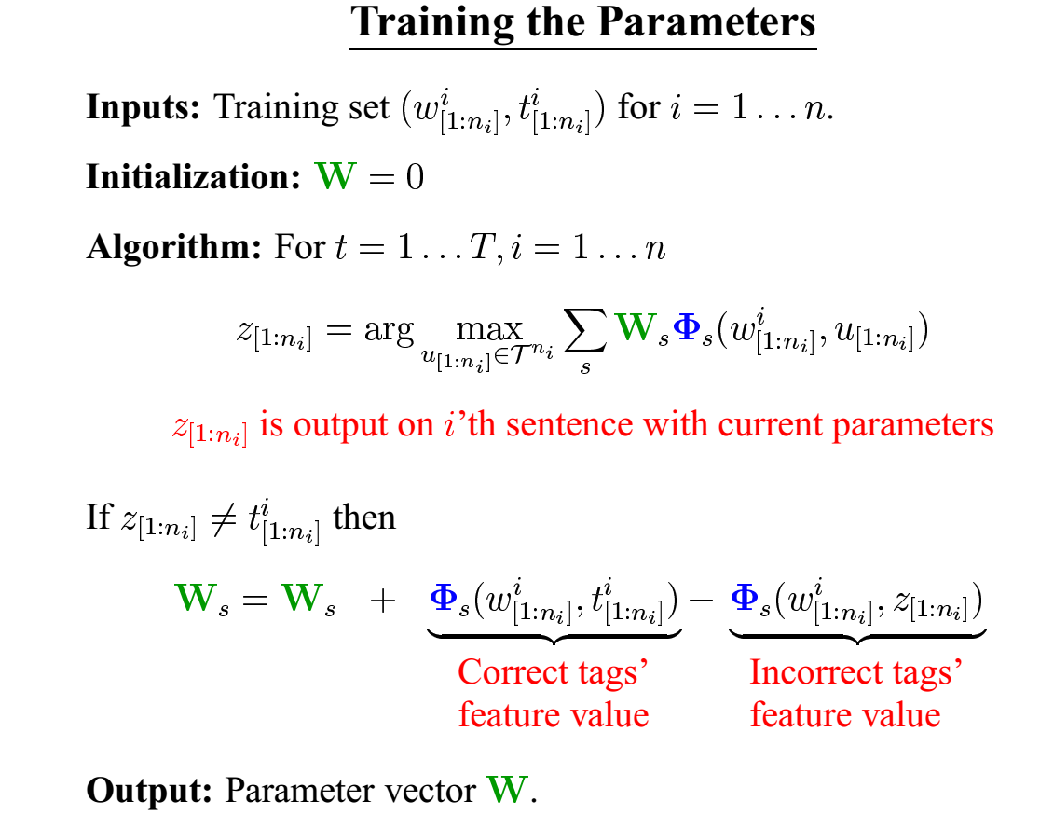

Slide 92
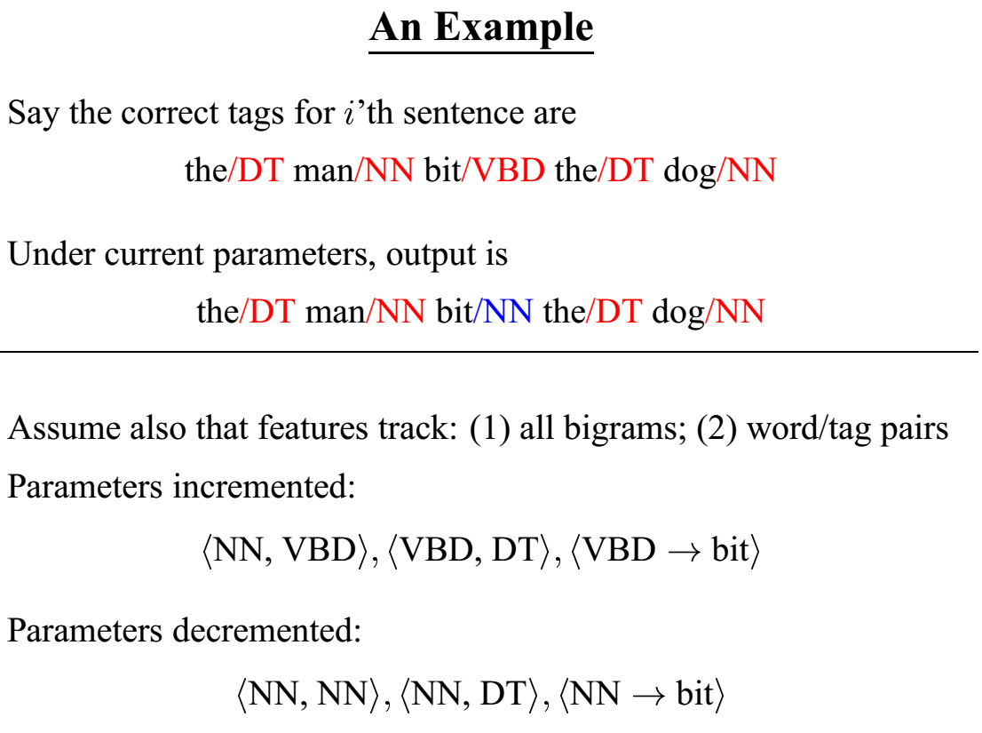

Slide 93
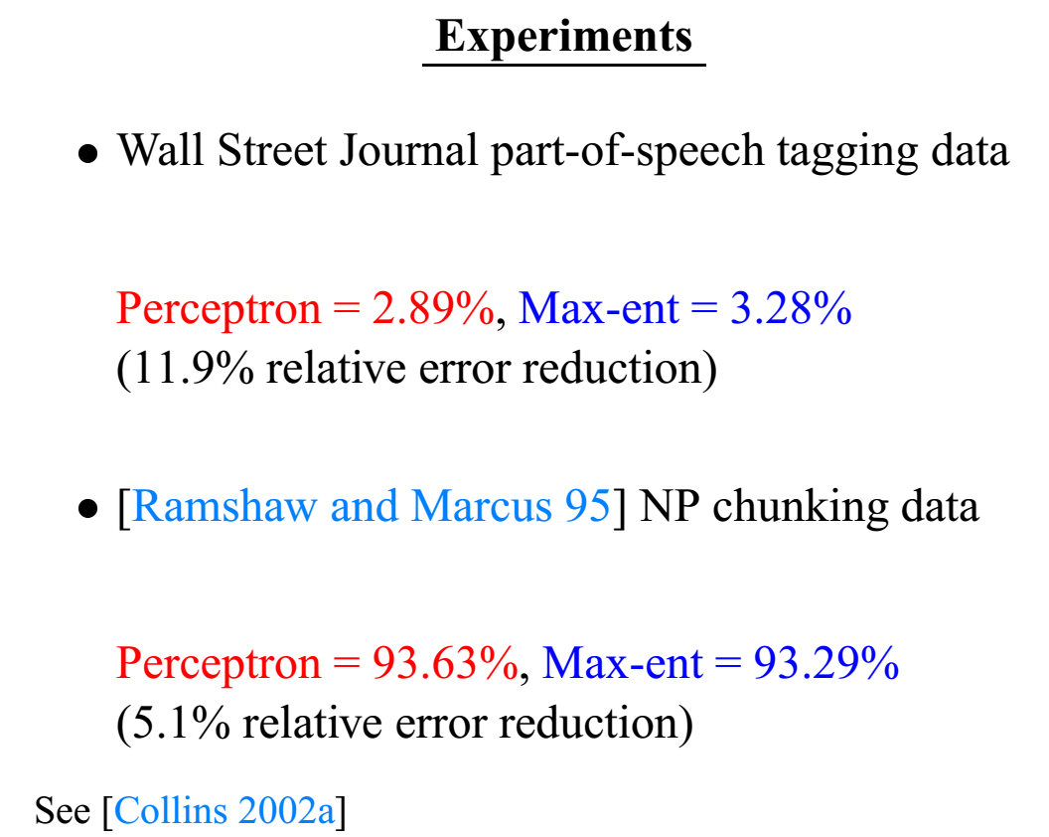

Slide 94
The need for nonlinear classifiers

Slide 95
Linear Classification can only classify certain data
Linear classifiers like SVMs
only draw straight lines,
but they transform the data first
in a way that makes that OK

Slide 97
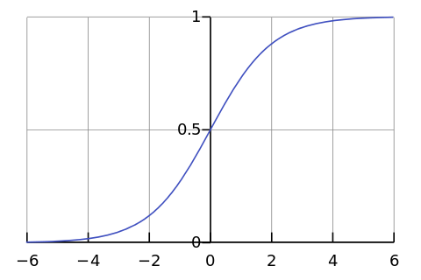

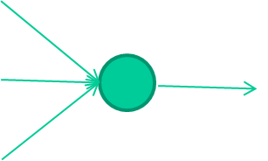
-0.06
W1
W2
f(x)
-2.5
W3
1.4
Simple one layer Neural Network

Slide 98
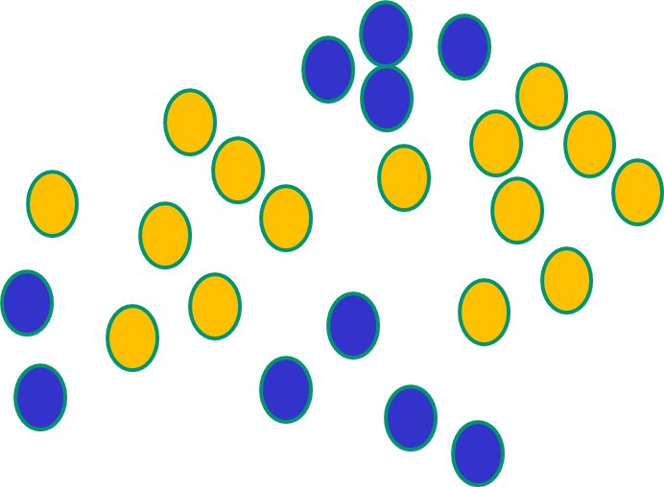
Linear Classification can only classify certain data
Linear classifiers like SVMs NNs use nonlinear f(x) so SVMs only draw straight lines, they can draw complex but they transform the data first boundaries, but keep the
in a way that makes that OK. data unchanged

Slide 99
Deep Neural Networks
DNNs can automatically learn feature representations, and are inherently more powerful than single layer NNs
So need to learn deep learning!

Slide 100
What is End-to-end Learning?

Slide 101
E2E learning
E2E learning means learning the direct relationship between the input and complex output. (Some ML classifiers assign simple labels, but not all)
Parsing, and machine translation are typical e2e learning tasks

Slide 102
Advantages of E2E learning
E2E learning can directly capture the objective of their ultimate task instead of minimizing some criterion such as negative log-likelihood, for the true cost of the system (the optimization objective evaluated on actual instantiations in the real world) may benefit from a model that actually attains worse overall likelihood, but makes more accurate predictions over certain manifolds of the underlying space.
Priya L. Donti et al, Task-based End-to-end Model Learning in Stochastic Optimization, NIPS 2017

Slide 103
The importance of Global meaning representation
Learning complex mappings in a E2E setting can benefit tremendously if we can learn a global meaning representation of the input.
This is why LSTMs (with a meaning representation component C_{t})are more powerful and why the encoding-->global meaning -->decoding is better than simple locality-based approaches like syntax based machine translation by parsing.

Slide 104
Further reading
Y. Bengio, Learning Deep Architectures for AI, Foundations and Trends in Machine Learning, 2(1), pp.1-127, 2009.
Ian Goodfellow, Aaron Courville, and Yoshua Bengio. Deep learning. Book in preparation for MIT Press, 2015. http://goodfeli.github.io/dlbook/

Slide 105
参考文献
Berger et al, A Maximum Entropy to Natural Language Processing
Berger’s ME tutorials:
http://www.cs.cmu.edu/~berger/maxent.html
Klein’s ACL 2003 tutorials
Adwait Ratnaparkhi的博士论文：
ftp://ftp.cis.upenn.edu/pub/ircs/tr/98-15/98-15.ps.gz

Slide 106
References
An Introduction to Conditional Random Fields for Relational Learning. Charles Sutton and Andrew McCallum. In Introduction to Statistical Relational Learning. Edited by Lise Getoor and Ben Taskar. MIT Press. 2006.
(including figures and formulae)
H. Wallach, "Efficient training of conditional random fields," Master's thesis, University of Edinburgh, 2002. http://citeseer.ist.psu.edu/wallach02efficient.html
John Lafferty, Andrew McCallum, and Fernando Pereira. Conditional random fields: Probabilistic models for segmenting and labeling sequence data. In Proceedings of ICML-01, pages 282-289, 2001.
Gene Prediction with Conditional Random Fields. Aron Culotta, David Kulp, and Andrew McCallum. Technical Report UM-CS-2005-028, University of Massachusetts, Amherst, April 2005.

Slide 107
References
Kevin Murphy. An introduction to graphical models. Technical report, Intel Research Technical Report., 2001. http://citeseer.ist.psu.edu/murphy01introduction.html
On Discriminative vs. Generative Classifiers: A comparison of logistic regression and Naive Bayes, Andrew Y. Ng and Michael Jordan. In NIPS 14,, 2002.
T. Minka. Discriminative models, not discriminative training. Technical report, Microsoft Research Cambridge, 2005.
P. Blunsom. Maximum Entropy Classification. Lecture slides 433-680. 2005. http://www.cs.mu.oz.au/680/lectures/week06a.pdf

